Slide 1
MEMORY ORGANIZATION
Memory Hierarchy
Main Memory
Auxiliary Memory
Associative Memory
Cache Memory
Virtual Memory
Memory Management Hardware

Slide 2
MEMORY HIERARCHY
Memory Hierarchy
Memory Hierarchy is to obtain the highest possible
access speed while minimizing the total cost of the memory system
Auxiliary memory
Magnetic
tapes
I/O
Main
processor
memory
Magnetic
disks
CPU
Cache
memory
Register
Cache
Main Memory
Magnetic Disk
Magnetic Tape

Slide 3
MAIN MEMORY
Main Memory
RAM and ROM Chips
Typical RAM chip
Chip select 1
CS1
Chip select 2
CS2
128 x 8
Read
RD
RAM
8-bit data bus
Write
WR
7-bit address
AD 7
CS1 CS2 RD WR
Memory function
State of data bus
0 0 x x
Inhibit
High-impedence
0 1 x x
Inhibit
High-impedence
1 0 0 0
Inhibit
High-impedence
1 0 0 1
Write
Input data to RAM
1 0 1 x
Read
Output data from RAM
1 1 x x
Inhibit
High-impedence
Typical ROM chip
Chip select 1
CS1
Chip select 2
CS2
512 x 8
8-bit data bus
ROM
9-bit address
AD 9

Slide 4
MEMORY ADDRESS MAP
Main Memory
Address space assignment to each memory chip
Example: 512 bytes RAM and 512 bytes ROM
Hexa
address
Address bus
Component
10 9 8 7 6 5 4 3 2 1
RAM 1
RAM 2
RAM 3
RAM 4
ROM
0000 - 007F
0080 - 00FF
0100 - 017F
0180 - 01FF
0200 - 03FF
0 0 0 x x x x x x x
0 0 1 x x x x x x x
0 1 0 x x x x x x x
0 1 1 x x x x x x x
1 x x x x x x x x x
Memory Connection to CPU
- RAM and ROM chips are connected to a CPU
through the data and address buses
- The low-order lines in the address bus select
the byte within the chips and other lines in the
address bus select a particular chip through
its chip select inputs

Slide 5

CONNECTION OF MEMORY TO CPU
Main Memory
Address bus
CPU
16-11
10
9
8
7-1
RD
WR
Data bus
Decoder
3
2
1
0
CS1
CS2
128 x 8
Data
RD
RAM 1
WR
AD7
CS1
CS2
128 x 8
Data
RD
RAM 2
WR
AD7
CS1
CS2
128 x 8
Data
RD
RAM 3
WR
AD7
CS1
CS2
128 x 8
RD
RAM 4
Data
WR
AD7
CS1
1- 7
CS2
512 x 8
8
ROM
Data
9
AD9

Slide 6
Auxiliary Memory
Most common auxiliary memory devices used in computer systems are magnetic disks and tapes.
not used as frequently, are magnetic drums, magnetic bubble memory, and optical disks.
important characteristics of any device are its access mode, access time, transfer rate, capacity, and cost.
What do you mean by access time?
Seek time ? Transfer rate?

Slide 7
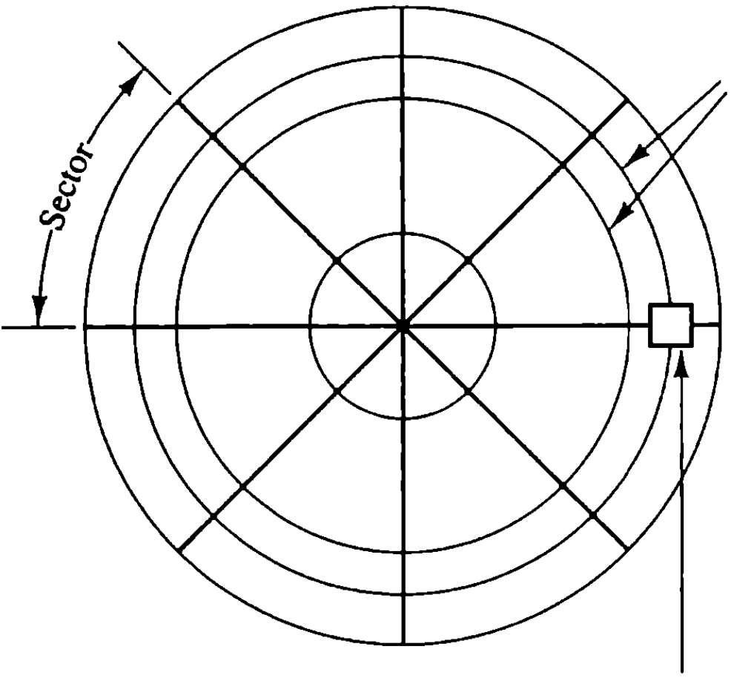
Magnetic disk
Tracks
Read/write
head

Slide 8
A magnetic disk is a circular plate constructed of metal or plastic coated with magnetized material.
Bits are stored in the magnetized surface in spots along concentric circles called tracks.
The tracks are commonly divided into sections called sectors.
A disk system is addressed by address bits that specify the disk number, the disk surface, the sector number and the track within the sector.
Disks that are permanently attached to the unit assembly and cannot be removed by the occasional user are called hard disks .
A disk drive with removable disks is called a floppy disk.

Slide 9
Magnetic Tap
A magnetic tape transport consists of the electrical, mechanical, and electronic components.
tape is a strip of plastic coated with a magnetic recording medium.
Bits are recorded as magnetic spots on the tape along several tracks.seven or nine bits are recorded simultaneously to form a character together with a parity bit.

Slide 10
Associative Memory
Data processing applications-searching a item-searching algorithms-search by specifying address or location.
A memory unit accessed by content is called an associative memory or content addressable memory (CAM).
Memory is accessed simultaneously and in parallel on the basis of data content rather than by specific address or location.

Slide 11
When a word is written in an associative memory, no address is given.
The memory is capable of finding an empty unused location to store the word.
When a word is to be read from an associative memory, the content of the word, or part of the word, is specified.
The memory locates all words which match the specified content and marks them for reading.
More expensive than RAM.Why?
Where used??

Slide 12
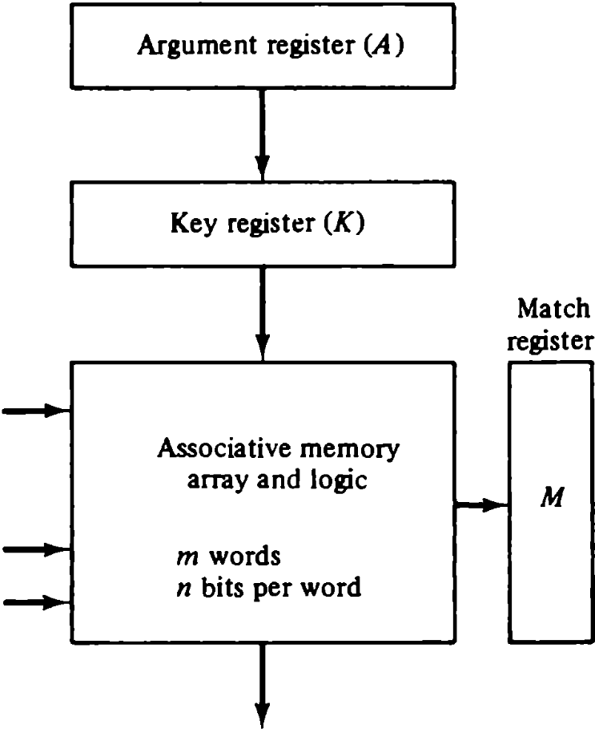
Hardware organization of
Associative Memory

Slide 13
suppose that the argument register A and the key register K have the bit configuration shown below. Only the three leftmost bits of A are compared with memory words because K has 1's in these positions.
A 110 100011
K 111 000000
Word 1 110 010110 Match
Word 2 101 011101 No Match

